Slide 1

Name: A.Manikandan Domain: Data Science Test: Milestone-1 Date: 22/07/2024
COFFEE QUALITY DATABASE

Slide 2
PROJECT WORKFLOW
Data loading and initial inspection
Data Cleaning
Exploratory Data Analysis
Feature Analysis and Visualization
Hypothesis Testing

Slide 3
Introduction
Data Understanding and Cleaning:
Load the coffee quality dataset and perform initial data inspection.
Clean the data by handling missing values, removing, duplicates, and standardizing column names.
Exploratory Data Analysis:
Generate summary statistics for numerical and categorical columns.
Visualize the distribution of numerical and categorical variables to understand their characteristics.

Slide 4
Feature Analysis and Visualization:
Create a correlation matrix to explore relationship between numerical feature.
Generate pair plots to visualize the relationship between numerical feature.
Create heatmap to examine relationships between categorical variables.
Use liner regression plots to study the relationships between pairs of numerical features.
Hypothesis Testing:
Perform chi-squared tests to investigate associations between categorical variables.
Conduct additional statistical tests (e.g., T-test, ANOVA) if necessary to explore relationship between numerical variables.

Slide 5
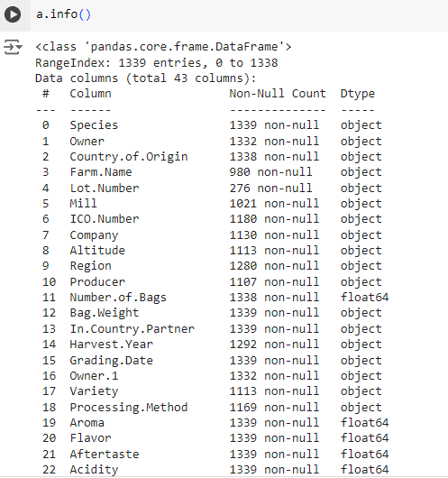
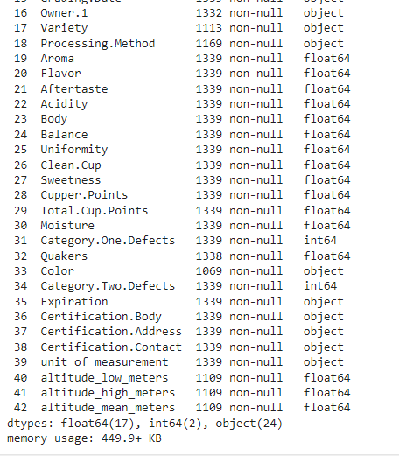
Data Understanding
Df.info(): summary information of the dataset.
this code will provide an overview of the dataframe.
The number of entries(rows).
The number of non-null entries in each column.
The data type of each column.
The memory usage of the dataframe.

Slide 6
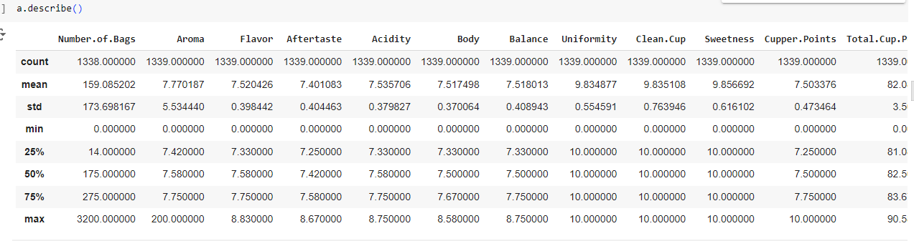
Df.describe(): summary for statistics for numerical columns in a dataframe.
Count: the number of non-null values.
Mean: the average value.
Std: the standard deviation, which measures the dispersion of values.
Min: the minimum value.
25%: the 25th percentile (first quartile).
50%: the 50th percentile (median).
75%: the 75th percentile (third quartile).
Max: the maximum value.

Slide 7
Initial Exploration
Patterns:
Central tendency: look for mean, median, and mode of the variable.
Distribution: check the distribution of data using histograms plot.
Relationship: identify any correlation or patterns between variable using scatter plot or correlation matrices.
Outliers:
Visual inspection: use box plots or scatter plots to visually identify outliers.
Statistical methods: calculate z-scores or use the IQR method to statistically identify outliers.

Slide 8
Relationships:
Correlation : correlation matrices to explore relationships between numerical variables.
Groupby: use groupby operation to explore relationships between categorical and numerical variables.
Missing values:
Count and percentage: determine the number and percentage of missing values in each column.
Patterns in missing data: check if there is a pattern in missing data.

Slide 9
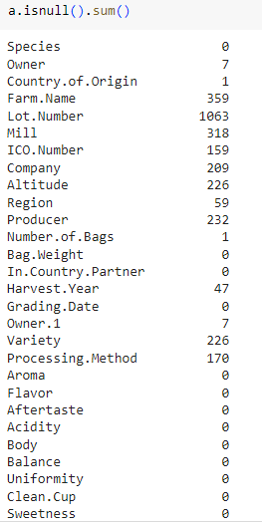
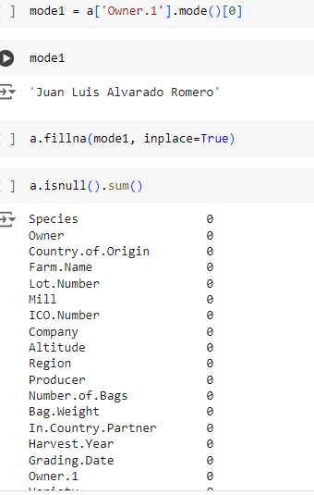
Missing values handling
Detect missing values: a.isnull().sum()
Handling missing values: mode ()

Slide 10
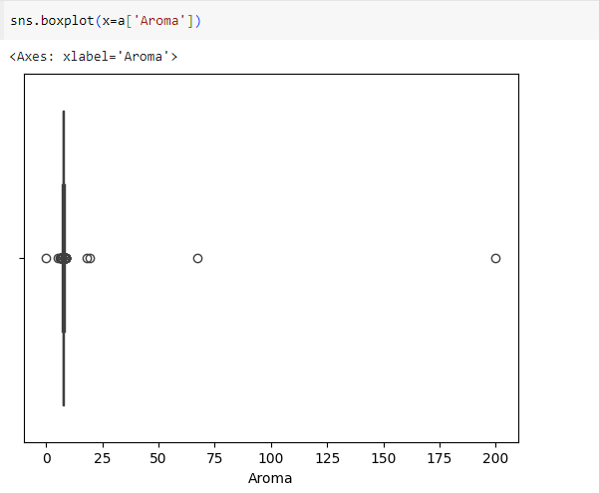
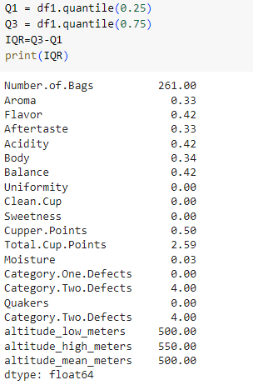
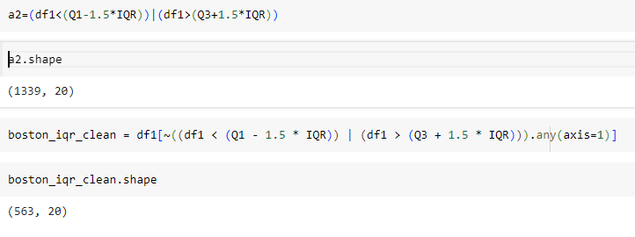
Outlier handling
Box plot:
use box plots to visually identify outliers in numerical columns.
IQR method:
use the IQR method to statistically identify outlier.

Slide 11
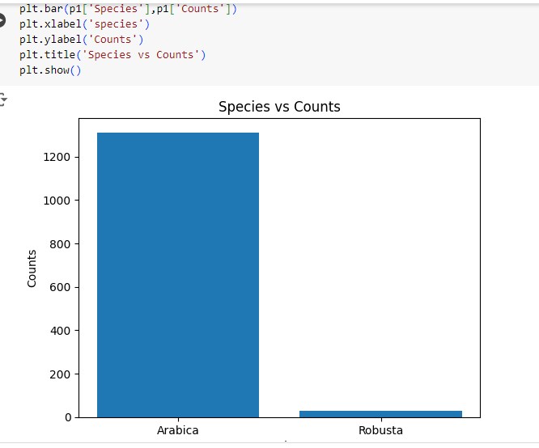
Data Visualization (EDA)
Bar plot: two axis(x,y)
X: this axis usually represent the categories being compared.
Y: this axis usually represent the values corresponding to each category.

Slide 12
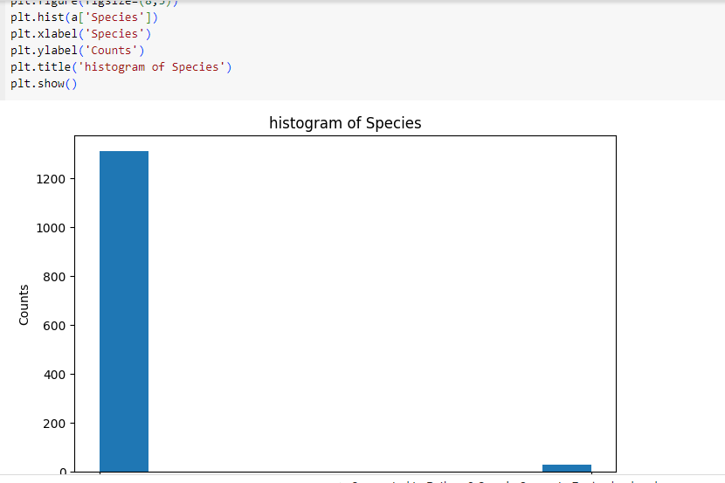
Histogram plot: this divides the range of values into intervals, called bins.

Slide 13
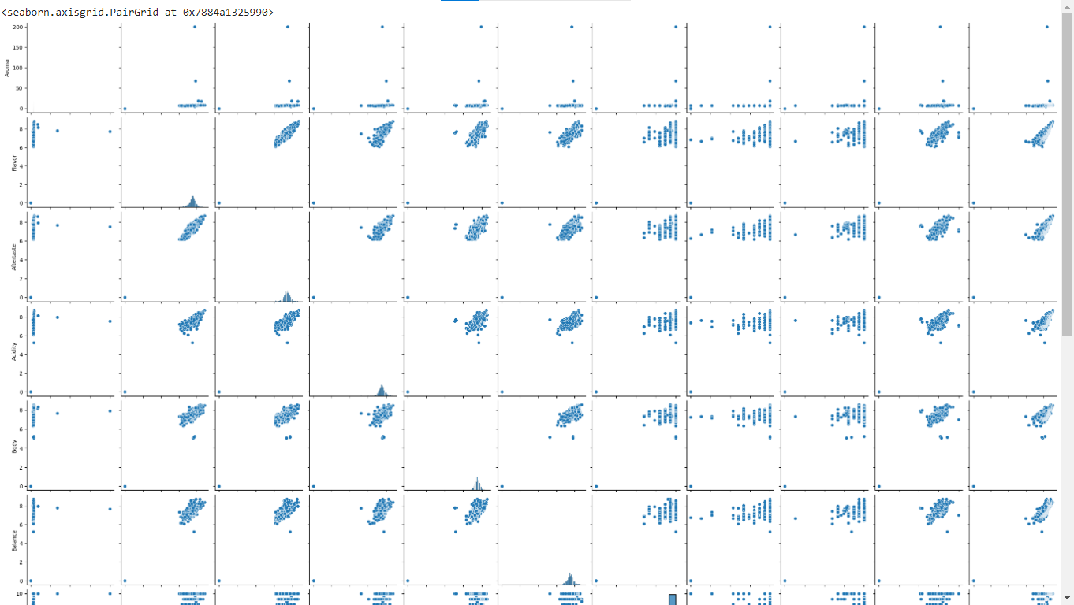
Pair plot: this type of plot used in data visualization to explore relationships between multiple variables in a dataset.

Slide 14
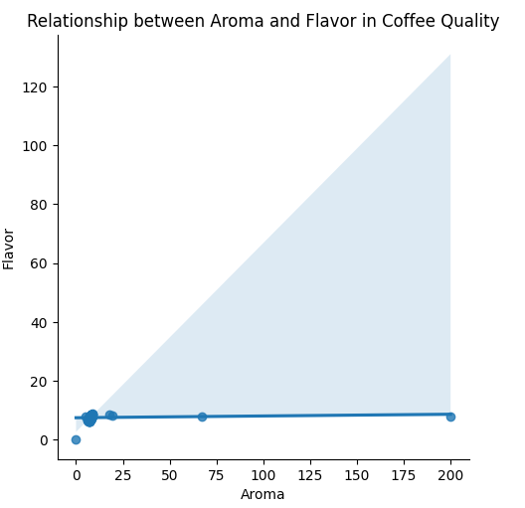
Lmplot: this (short for “linear model plot”)type of plot used to visualize linear relationships between variables.

Slide 15
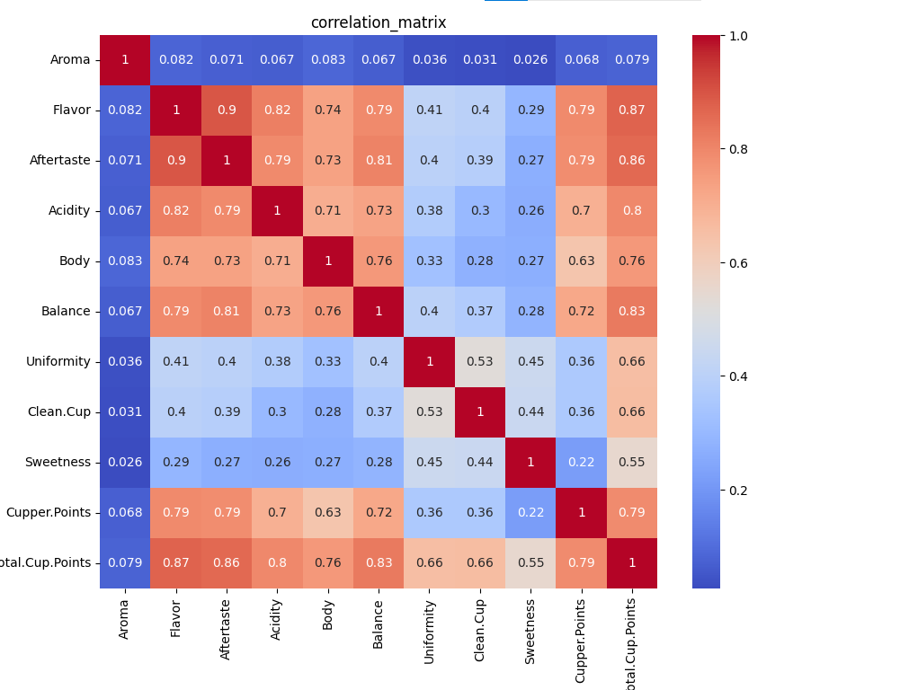
Heatmap: is a data visualization technique that represent data in a matrix format. Where individual values are represented by varying colors. It is especially useful for visualizing the intensity or magnitude of data across a grid or table.

Slide 16
THANK YOU.

